Slide 1
PREDICTING HOUSE PRICE USING MACHINE LEARNING
PROJECT : HOUSE PRICE PREDICTION

Slide 2
OBJECTIVE:
The objective of the project is to develop a machine learning moded that
Accurately protect the prices of house based on house set of features such as location,
Square footage number of bedroom and bathroom and other revalent factor.
Phase 1: DATA PREPROCESSING AND FEATURE ENGINEERING
House Price Prediction using Machine Learning
So to deal with this kind of issues Today we will be preparing a MACHINE LEARNING Based model, trained on the House Price Prediction Dataset.

Slide 3
1 | Id | To count the records.
2 | MSSubClass | Identifies the type of dwelling involved in the sale.
3 | MSZoning | Identifies the general zoning classification of the sale.
4 | LotArea | Lot size in square feet.
5 | LotConfig | Configuration of the lot
6 | BldgType | Type of dwelling
7 | OverallCond | Rates the overall condition of the house
8 | YearBuilt | Original construction year
9 | YearRemodAdd | Remodel date (same as construction date if no remodeling or additions).
10 | Exterior1st | Exterior covering on house
11 | BsmtFinSF2 | Type 2 finished square feet.
12 | TotalBsmtSF | Total square feet of basement area
13 | SalePrice | To be predicted

Slide 4
Importing Libraries and Dataset
Here we are using
Pandas – To load the Dataframe
Matplotlib – To visualize the data features i.e. barplot
Seaborn – To see the correlation between features using heatmap
Python3
import pandas as pd import matplotlib.pyplot as plt import seaborn as sns dataset = pd.read_excel("HousePricePrediction.xlsx") # Printing first 5 records of the dataset print(dataset.head(5))

Slide 5
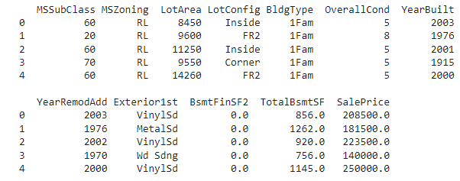
OUTPUT:

Slide 6
Data Preprocessing
Now, we categorize the features depending on their datatype (int, float, object) and then calculate the number of them.
plt.figure(figsize=(12, 6))
sns.heatmap(dataset.corr(),
cmap = 'BrBG',
fmt = '.2f',
linewidths = 2,
annot = True)

Slide 7
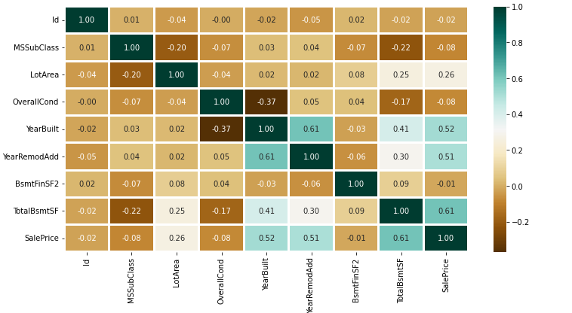
OUTPUT:

Slide 8
Conclusion
Clearly, SVM model is giving better accuracy as the mean absolute error is the least among all the other regressor models i.e. 0.18 approx. To get much better results ensemble learning techniques like Bagging and Boosting can also be used.

